Slide 1




ASP.NET Core Filters
Built-in & Custom Filters
C# MVC Frameworks
SoftUni Team
Technical Trainers
Software University
http://softuni.bg

Slide 2
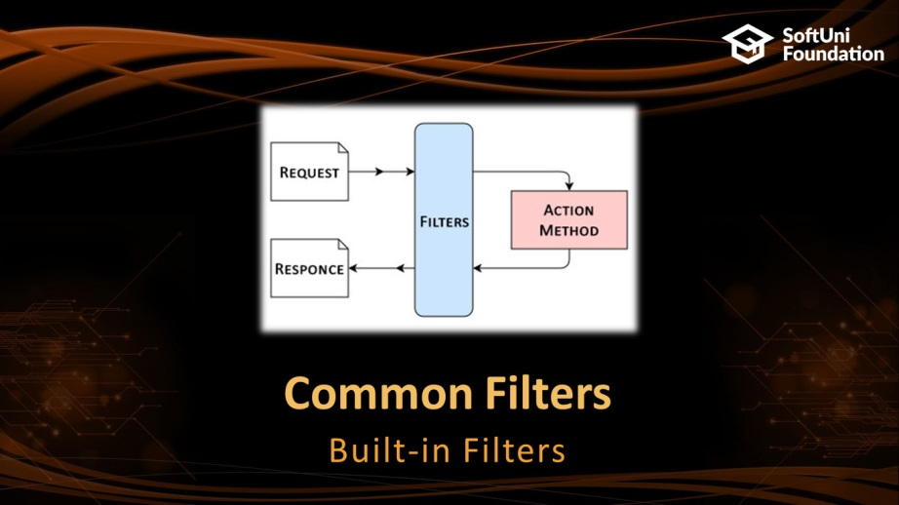
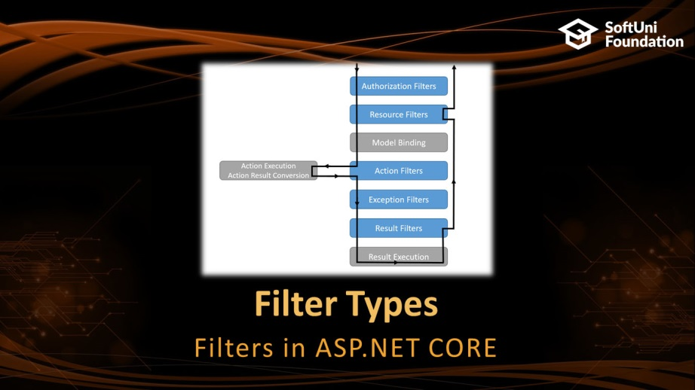

Table of Contents

Slide 3
Questions
sli.do #csharp-web

Slide 4
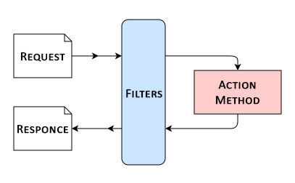
Common Filters
Built-in Filters

Slide 5

Common Filters
ASP.NET Core includes three filters for antiforgery tokens:
ValidateAntiForgeryToken
AutoValidateAntiforgeryToken
IgnoreAntiforgeryToken
Response caching – ResponseCacheAttribute
[ResponseCache(Duration = 60)]
60 seconds

Slide 6
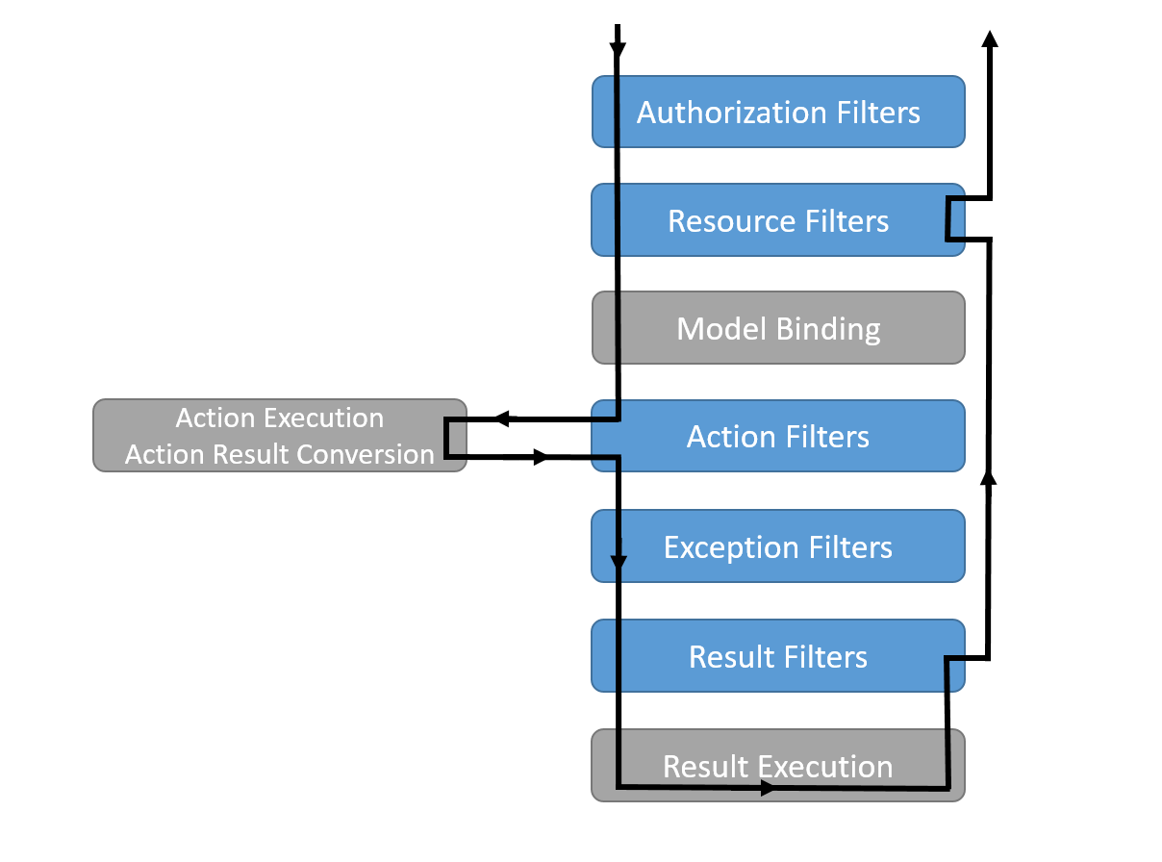
Filter Types
Filters in ASP.NET CORE

Slide 7


Filter Types
Authorization Filters: Implements IAuthorizationFilter
Security policy including user authorization.
Action Filters: Implements IActionFilter
Process logic before or after action method
Result Filters: Implements IResultFilter
Process logic before or after the result of action method
Exception Filters: Implements IExceptionFilter
Handle exceptions

Slide 8
Context Data
Filters are provided with context data
ActionDescriptor - describes the action method
HttpContext - details of the HTTP request and response
ModelState - state of HTTP Request values including validation information
RouteData - the way that the routing system has processed the request
Filters - list of filters that have been applied to the action

Slide 9
Global Filters
Registering Global Filters in the Startup.cs File
public void ConfigureServices(IServiceCollection
services)
{
services.AddMvc(options =>
{
options.Filters.Add(new GlobalFilterName());
options.Filters.Add(typeof(SimpleFilter));
});
}
An Instance
By Type

Slide 10

Custom Filters
Create Your Own Filters

Slide 11

Authorization Filter
Inherit Attribute and IAuthorizationFilter
Implementing the interface gives us:
OnAuthorization(AuthorizationFilterContext)
public class MyHttpsOnlyAttribute : Attribute,
IAuthorizationFilter
{ … }

Slide 12

Action Filter
Inherit ActionFilterAttribute
We can override the following methods:
OnActionExecuting(ActionExecutingContext)
OnActionExecuted(ActionExecutedContext)
OnResultExecuting(ResultExecutingContext)
OnResultExecuted(ResultExecutedContext)
public class LogAttribute : ActionFilterAttribute
{ … }

Slide 13
Result Filter
Inherit ResultFilterAttribute
We can override the following methods:
OnResultExecuting(ResultExecutingContext)
OnResultExecuted(ResultExecutedContext)
public class ResultDetailsAttribute :
ResultFilterAttribute
{ … }

Slide 14

Exception Filter
Inherit ExceptionFilterAttribute
We can override the following methods:
OnException(ExceptionContext)
ExceptionContext properties:
Exception - Exception that was thrown
ExceptionDispatchInfo - stack trace details
public class RangeExceptionAttribute :
ExceptionFilterAttribute
{ … }

Slide 15

Summary
ASP.NET Core Filters
Common Filters
Filter Types
Pre / Post Filters
Context Data
Custom Filters
Creating Authorization Filter
Creating Action Filter
Creating Result Filter
Creating Exception Filter

Slide 16







C# MVC Frameworks – Course Overview
https://softuni.bg/courses/asp-net-mvc

Slide 17
License
This course (slides, examples, demos, videos, homework, etc.) is licensed under the "Creative Commons Attribution-NonCommercial-ShareAlike 4.0 International" license

Slide 18





Trainings @ Software University (SoftUni)
Software University – High-Quality Education, Profession and Job for Software Developers
softuni.bg
Software University Foundation
http://softuni.foundation/
Software University @ Facebook
facebook.com/SoftwareUniversity
Software University Forums
forum.softuni.bg

